Slide 1


Nephros, Inc. (Nasdaq: NEPH)
Annual Meeting
May 21, 2020

Slide 2
Safe Harbor Statement
Certain statements in this management presentation constitute “forward-looking statements.” Such statements include those regarding the efficacy and intended use of our technologies under development, the timelines and strategy for bringing such products to market, the availability of funding sources for continued development of such products, and other statements that are not historical facts, including statements that may be preceded by the words “intends,” “may,” “will,” “plans,” “expects,” “anticipates,” “projects,” “predicts,” “estimates,” “aims,” “believes,” “hopes,” “potential” or similar words. Forward-looking statements are not guarantees of future performance, are based on certain assumptions and are subject to various known and unknown risks and uncertainties, many of which are beyond our control. Actual results may differ materially from the expectations contained in the forward-looking statements. Factors that may cause such differences include, but are not limited to, that (i) we face significant challenges in obtaining market acceptance of our products, which could adversely affect our potential sales and revenues; (ii) product-related deaths or serious injuries or product malfunctions could trigger recalls, class action lawsuits and other events that could cause us to incur expenses and may also limit our ability to generate revenues from such products; (iii) we face potential liability associated with the production, marketing and sale of our products, and the expense of defending against claims of product liability could materially deplete our assets and generate negative publicity, which could impair our reputation; (iv) to the extent our products or marketing materials are found to violate any provisions of the U.S. Food, Drug and Cosmetic Act (the “FDC Act”) or any other statutes or regulations, we could be subject to enforcement actions by the U.S. Food and Drug Administration (the “FDA”) or other governmental agencies; (v) we may not be able to obtain funding if and when needed or on terms favorable to us in order to continue operations; (vi) we may not have sufficient capital to successfully implement our business plan; (vii) we may not be able to effectively market our products; (viii) we may not be able to sell our water filtration products or chronic renal failure therapy products at competitive prices or profitably; (ix) we may encounter problems with our suppliers, manufacturers and distributors; (x) we may encounter unanticipated internal control deficiencies or weaknesses or ineffective disclosure controls and procedures; (xi) we may not be able to obtain appropriate or necessary regulatory approvals to achieve our business plan; (xii) products that appeared promising to us in research or clinical trials may not demonstrate anticipated efficacy, safety or cost savings in subsequent pre-clinical or clinical trials; (xiii) we may not be able to secure or enforce adequate legal protection, including patent protection, for our products; (xiv) we may not be able to achieve sales growth in key geographic markets; and (xv) the effects of the Covid-19 pandemic may be more severe than we currently anticipate. More detailed information about us and the risk factors that may affect the realization of forward-looking statements, including the forward-looking statements in this management presentation, is set forth in our filings with the SEC, including our Annual Report on Form 10-K for the fiscal year ended December 31, 2019 and our other periodic reports filed with the SEC. We urge you to read those documents free of charge at the SEC’s web site at www.sec.gov. We do not undertake to publicly update or revise our forward-looking statements as a result of new information, future events or otherwise, except as required by law.

Slide 3
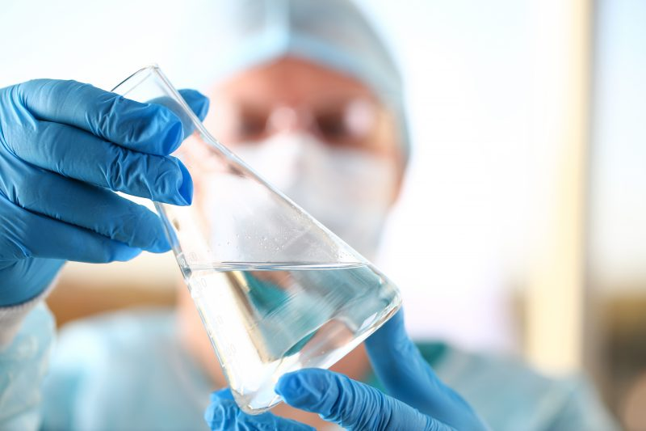
Our Vision & Mission
Nephros provides innovative and superior technologies that provide water safety solutions, delivered to our customers with unparalleled quality, reliability and service.
Debris Retained
Product Water Delivered
The DSU-H is FDA Cleared (bacteria & virus) to aid in infection control for up to 180-days

Slide 4

Management Team
Daron Evans, MS, MBA
President & CEO
Shane Sullivan
VP Sales
CFO Nile Therapeutics, Inc. (now CAPR)
J&J, Arthur D. Little, Booz Allen & Hamilton
MBA Duke, BS Chem Eng, MS Biomed Eng
Nephros 7+ years
10 years Regional Manager at Thermo Scientific
BS Business, USC
Andy Astor, MBA
COO & CFO
Greg Lucas
President, Aether/Commercial
President/CFO, OpenSCG (acquired by AMZN)
Founder/CEO EnterpriseDB, VP Asurion, VP D&B, EY
MBA Wharton, BA Mathematics Clark University
Founder/Owner Biocon/Aether Water Systems
Executive at Gallo Wines
Michael Milman
VP Research & Development
Kimothy Smith
VP Pathogen Detection Products
10+ years Nephros, 15+ years design and dev.
R&D engineer with Stryker
BS Mechanical Engineering, Lehigh University
Molecular genetics, pathogen detection, food safety
Professor of Microbiology/Epidemiology, U Nevada
PhD Epidemiology
Vashone Thomas
VP Quality and Regulatory
Tony Robinson
VP Operations, Specialty Renal Products
Previously Integrated Dental Systems
10+ years quality leadership
MS Pace University
Expert in medical device development
FDA clearance experience
15 years of leadership roles
4

Slide 5
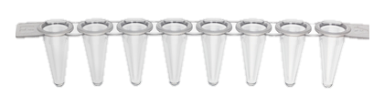



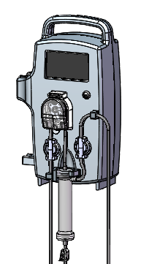
Nephros: Three Business Segments
Established and growing water filtration base business plus a recently launched pathogen detection product and potentially transformative dialysis device to be launched in 2020
Growing Base Business
New Product Line Launches
Water Filtration
Pathogen Detection (PluraPath™)
Leading provider of ultrafilters to protect from waterborne pathogens
Mobile qPCR water-borne pathogen detection system
$8 billion highly fragmented global market
Real-time data (results in 1 hour)
15 different assays simultaneously
DialyPathTM and SequaPathTM in the pipeline
100% of historical revenue
Recurring revenue: razor / razor blade model
High gross margins (55-60%)
Cash flow breakeven
Impressive revenue growth: 62% average growth YoY for 15 consecutive quarters
Growing end-markets: hospitals, hospitality / food service, dialysis
HDF Dialysis
Enables hemodialysis machine to perform hemodiafiltration treatment
Targeting 2020 relaunch
Over 15% of patients on HDF in Europe

Slide 6
15 Consecutive Quarters of Growth Averaging 62% (YoY)

Slide 7
2015 — 2019 Performance vs. Q1 2020

Slide 8
2015 — 2019 Performance vs. Q1 2020

Slide 9
Long-Term Expectations Remain Strong
Resumption of new customer meetings
Resumption of industry conferences
Increased pathogen outbreaks as weather warms
Large commercial opportunities are in the pipeline
Big PluraPath opportunities, with greater general awareness of pathogen risks and qPCR

Slide 10

Water Filtration

Slide 11
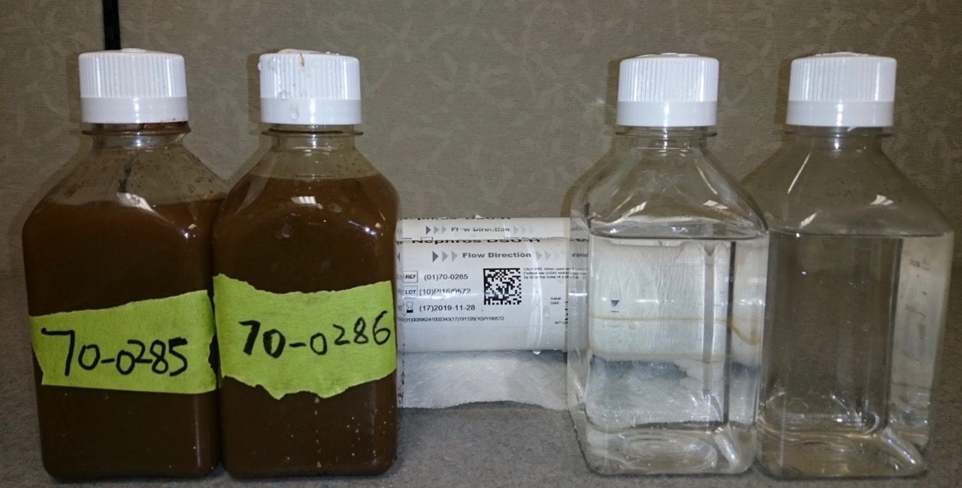
What Does a Nephros Ultrafilter Do?
Nephros Ultrafilters protect patients and consumers from water-borne pathogens
Actual Backwash of a Nephros Ultrafilter After 6 Months
Debris Retained
Product Water Delivered
The DSU-H is FDA Cleared (bacteria & virus) to aid in infection control for up to 180-days

Slide 12
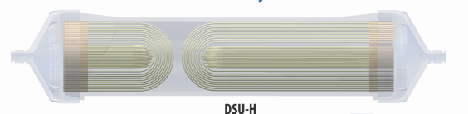
Nephros Proprietary Membrane Technology
Conventional microfilters can stop most, but not all bacteria and are insufficient in filtering viruses and endotoxins
Conventional Microfilters
(0.2 μm pore size)
Nephros
Ultrafilters
(0.005 μm pore size)
Bacteria
Nephros Ultrafilters stop all bacteria, viruses, endotoxins
Viruses
Endotoxins
Nephros ultrafilter pore size: 40x smaller than conventional filters

Slide 13
Nephros Proprietary Membrane Technology
Nephros’ proprietary membrane technology offers smallest pore size without compromising flow rate and filter life
KEY FEATURES IN WATER FILTERS
LEADING COMPETITOR*
NEPHROS
Filtration
(Pore Size)
40x Smaller Pore Size
0.2 μm
0.005 μm
Filter Life
2 – 3x competitor
31-62 days
90 – 360 days
Flow Rate
(Membrane Surface Area)
3 – 28x
competitor
0.06-0.1 m2
0.3-2.8 m2
Nephros filters dramatically improve performance at a smaller cost per day vs. conventional filters
* versus Pall AquaSafe

Slide 14
Hospital Filtration Growth Drivers
Nephros FDA 510(K) Clearances
Nephros Water Safety Professionals Distribution Network
CMS Water Safety Requirement
ASHRAE 188
Increased Pathogen Awareness
2015
2016
2017
2018
2019
2020

Slide 15
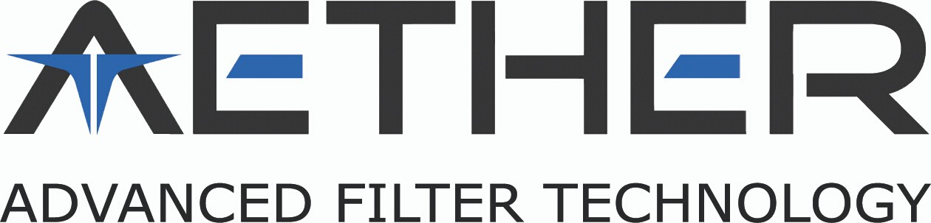
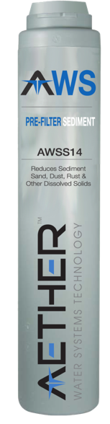
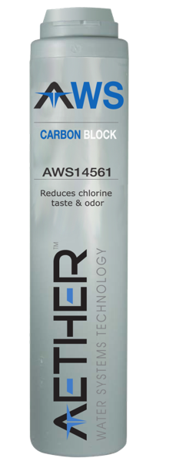


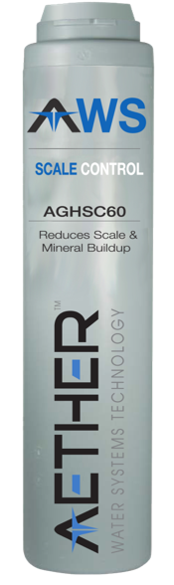


Introduction to Aether
Fountain Soda
Coffee
Tea
Ice

Slide 16

Aether Product Features
Filters fit multiple common manifolds for plug-and-play replacement
Reduce Chlorine/Chloramines Flow Rate 2 - 15 GPM
Scale Inhibitor - No Polyphosphates
Certified E.coli (6-log) Control
NSF/ANSI 42, 43 and 61 Certified Components
Made in the USA

Slide 17
Pathogen Detection

Slide 18
Pathogen Detection: Introducing PluraPath™
June 2017: CMS mandates all healthcare facilities have a water management plan. Mandate requires:
  Healthcare facilities must have a plan
  Plan must be enforced and water must be tested
  Must take action if pathogens are detected
    Install filters
    Chemical cleanse (chlorine, etc.)
Services and Products Offered by Water Service Partners
PluraPath™ Enables Testing Sales
Current Nephros Sales
Benefits
Assays Include:
On-site pathogen detection (no need to ship to lab)
Tested by own employees (not lab technicians)
Real-time results (in ~1 hour)
15 pathogen panel tested simultaneously with a single water sample
Legionella
E. coli
Pseudomonas
Shigella
Salmonella
Mycobacterium
Norovirus
Rotovirus
Mycobacterium
Camylobacter

Slide 19
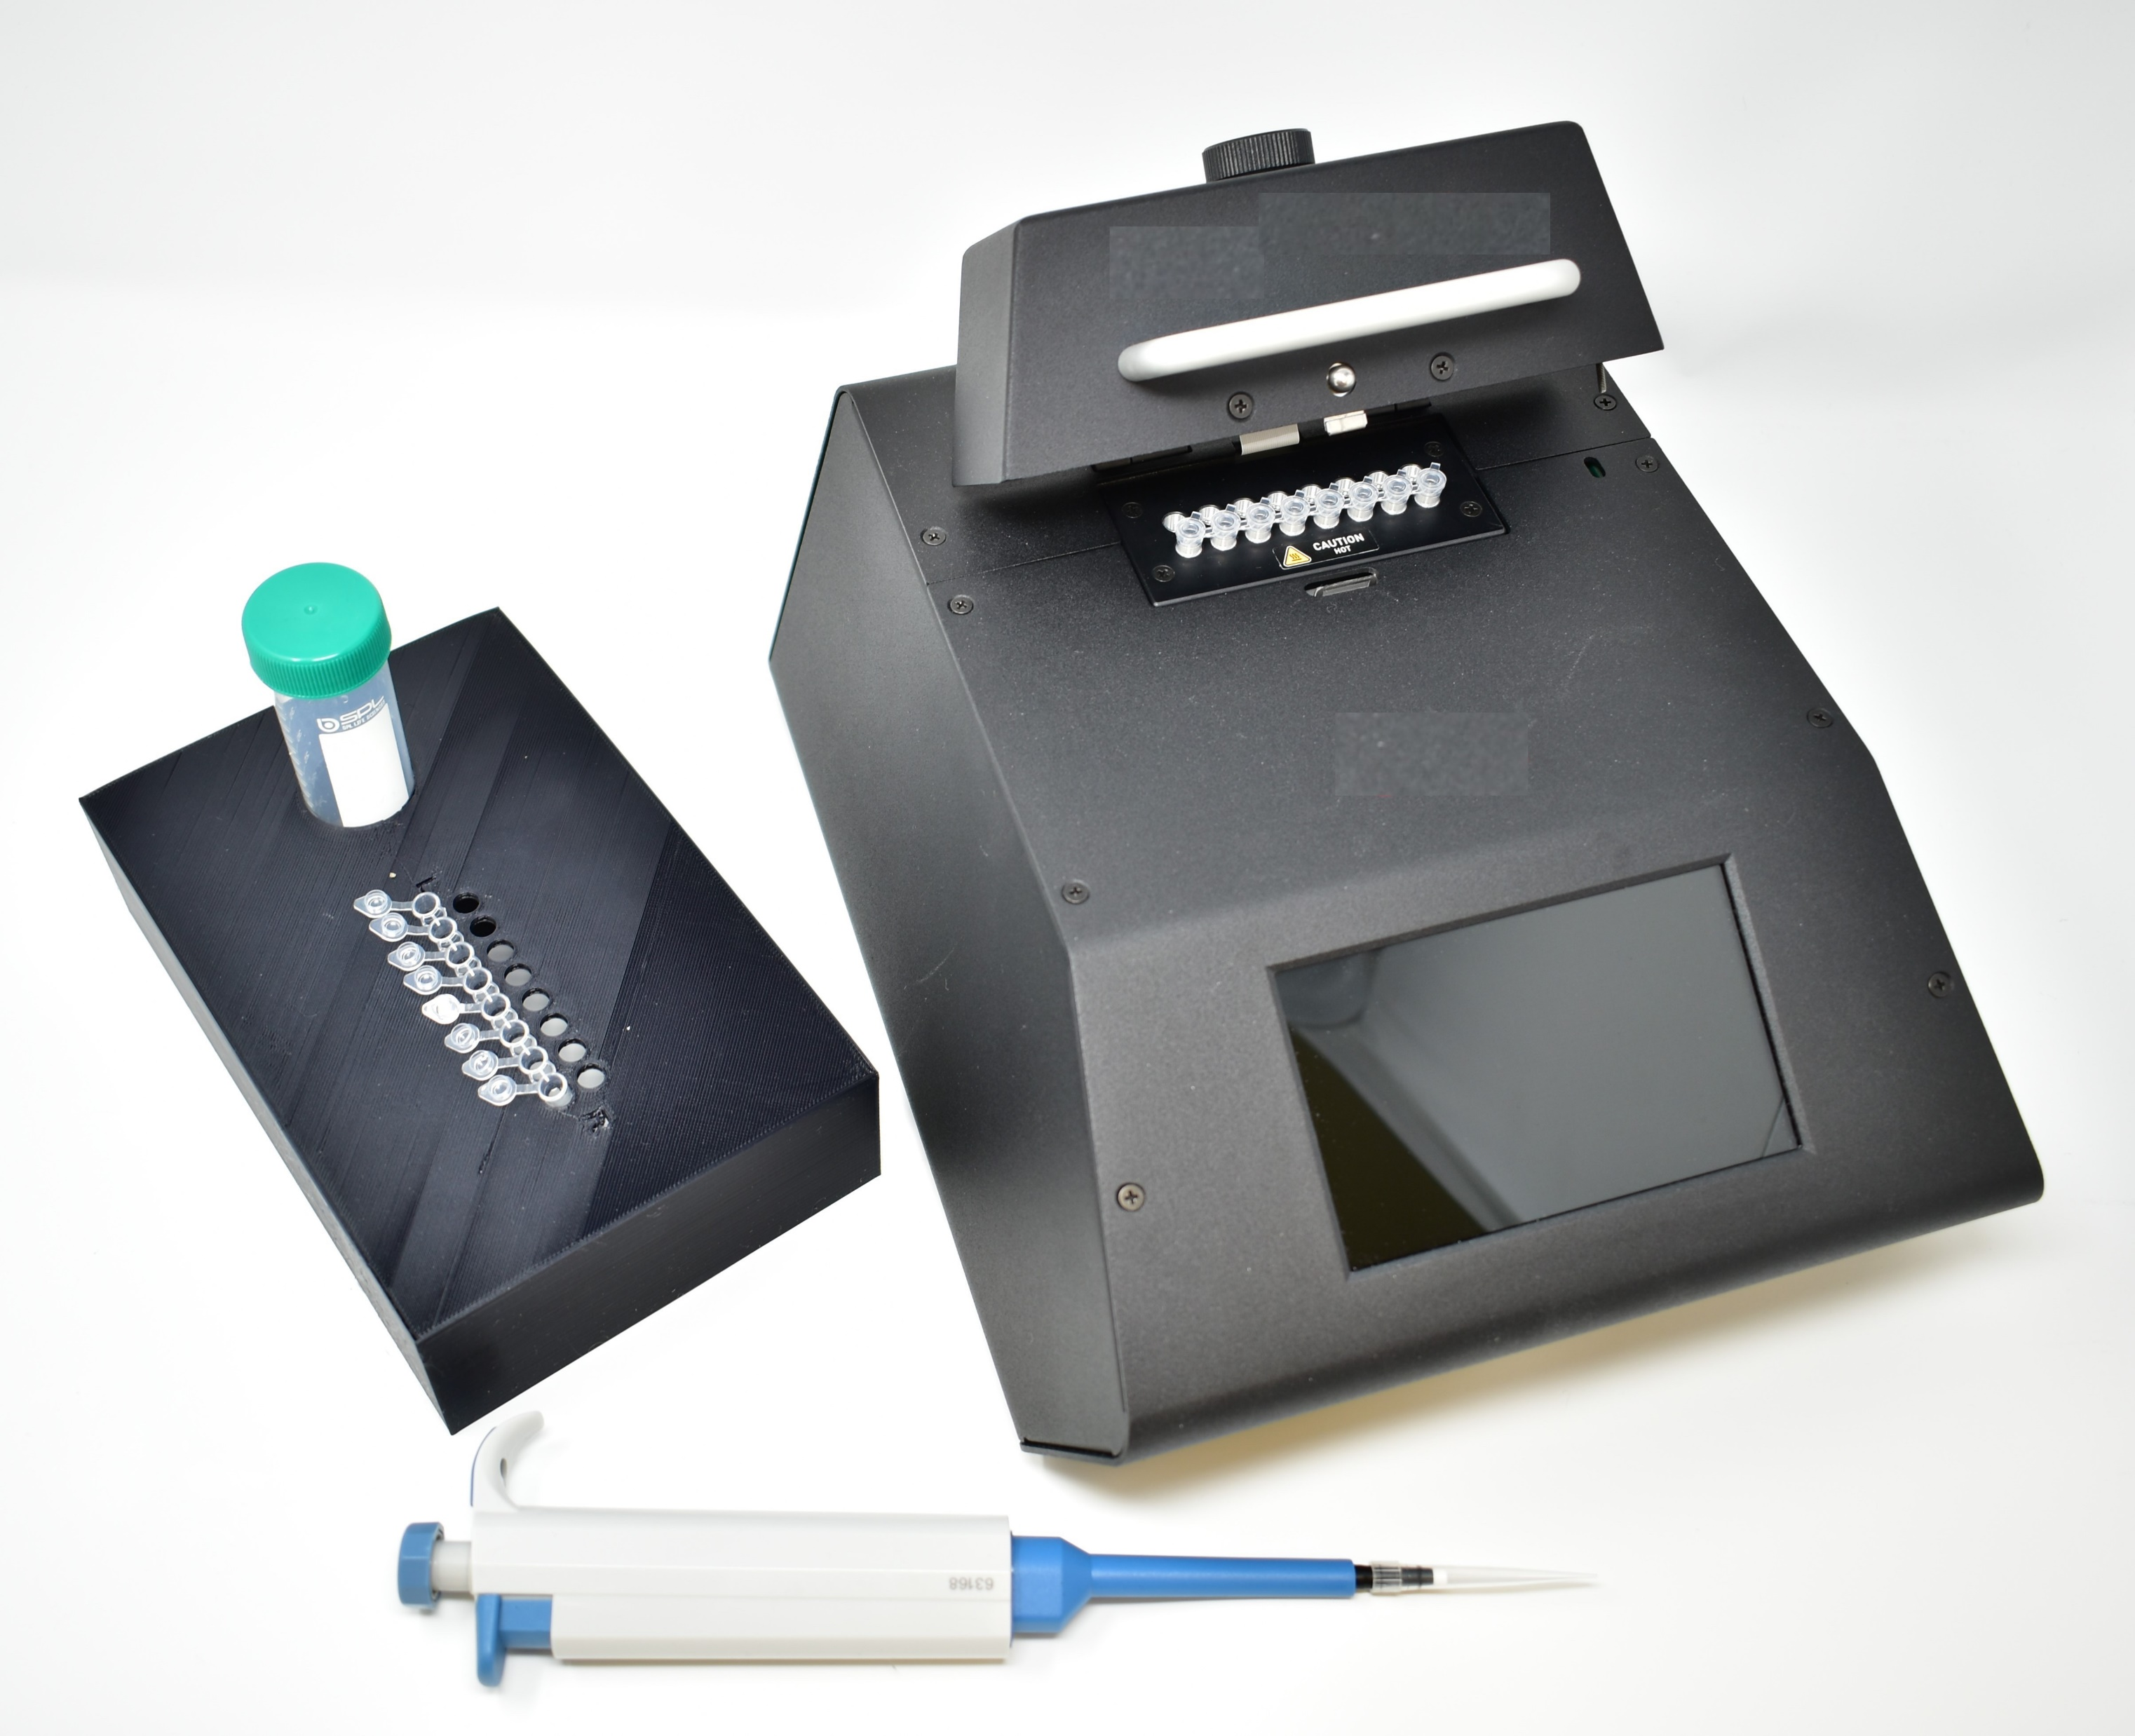
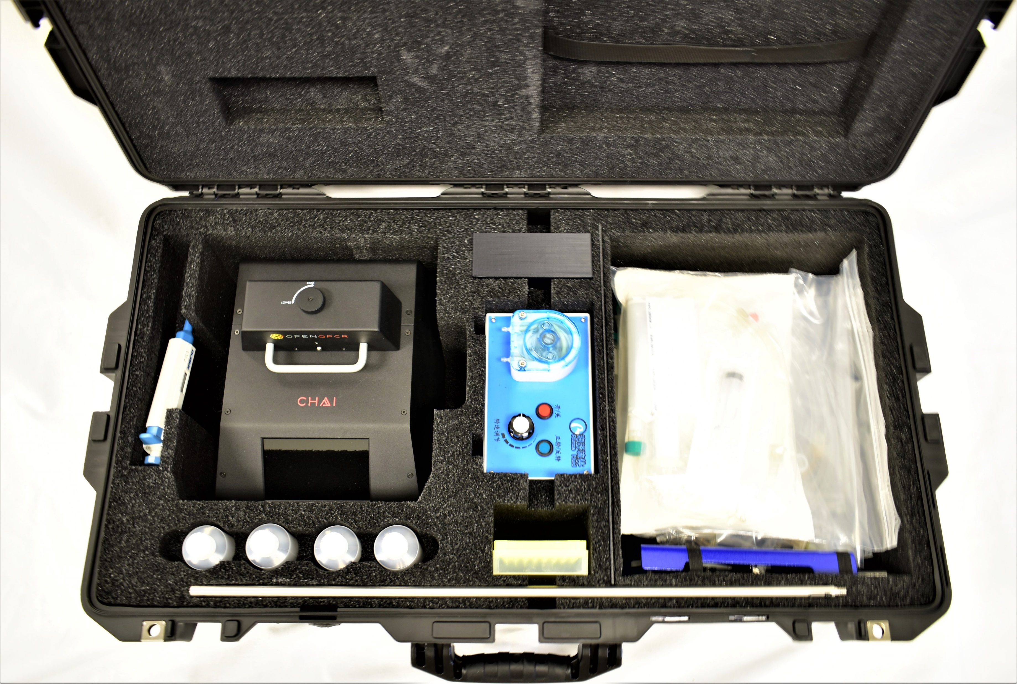
Pathogen Detection: Introducing PluraPath™
Nephros uses the same distributors as the filtration business to market PluraPath™
Largely Recurring Revenue
Expecting similar margins as the filtration business
Performs 15 separate DNA/RNA assays from a 1-liter water sample in approximately 1 hour
Portable, Real-time Open Source Thermocycler
Step 1: Collect 1-liter sample into sterile bag
Step 2: Concentrate test sample w/ Nephros ultrafilter
Step 3: Aliquot concentrate into an 8-well PCR test strip
Step 4: Initiate portable real-time thermocycler
Step 5: Thermocycler runs automatically for about 30 minutes
Step 6: Upload data and review report w/ Nephros Mobile App
Custom Pelican Case for Easy Portability

Slide 20

Additional Pathogen Detection Launches
Nephros will use its base pathogen detection technology to launch additional detection products
DialyPath™
SequaPath™
Entry into Dialysis Pathogen Detection
Entry into Biome Mapping Services
Dialysis clinics much shut down when contaminated
Current standard test (limulus amebocyte lysate (“LAL”)) routinely take over 48 – 72 hours and are shipped to a central laboratory
DialyPath™ uses PluraPath™ technology and is able to test endotoxins in real-time (1 hour)
Plan to launch DialyPath™ in Q2 2020
Ability to process 96 samples at once
Ability to recognize over 20,000 different bacteria references in one day
Will offer this product as a service
Expected launch in late 2020
Reduction in time to results
Full building biome map
Provide estimate of endotoxin levels equivalent to LAL
Provides estimated levels of ANY known bacteria
Provide estimated levels of 6 gram-negative bacteria
Transformation from a “water filter” company to a
“water solutions” company

Slide 21
Specialty Renal Products, Inc. (SRP)

Slide 22
Specialty Renal Products
SRP Organizational Objective:
Develop, Launch, and Market a tool to arm the clinician with the ability to safely and easily implement Hemodiafiltration (HFD) into the course of care for patients with end stage renal disease.
SRP HDF Gen 2
Improved Outcomes
Ease of Use
Reduced Cost
Supported by Clinical Research
SRP HDF Gen-2 Clinical Value

Slide 23
Specialty Renal Products
Pathway to Success:
Develop Improved HDF System (Safe & Effective)
Obtain Regulatory Clearance (Special 510k)
Manufacture HDF System (Cost-Effective)
Educate Industry (Clinical Value)
Status Update / Next Steps:
Clear Operational Strategy
Finalized Design of HDF Device
Critical Relationships in Place
Defined Regulatory Pathway
Framework for Clinical Substantiation and Go-to-Market Strategy
Targeted Timeline
----------2019----------I I----------------------------------------- 2020 -----------------------------------------I I-------------------2021------------
Define Medical Need
Product Development
Regulatory Submission / Clearance
Develop Clinical Footprint / Industry Education
Sales
Pathway to Success

Slide 24
Nephros, Inc.
380 Lackawanna Place
South Orange, NJ 07079
P: 201.343.5202
www.nephros.com
Thank You
Investor Relations Contacts:
Kirin Smith, President
PCG Advisory
ksmith@pcgadvisory.com
(646) 823-8656
Andy Astor, COO & CFO
Nephros, Inc.
andy@nephros.com
201.345.0824

